Slide 1
How to Merge Noisy Datasets
PyCon Ireland, November 6th 2016
Johannes Ahlmann

Slide 2

About Johannes
Over a decade coding in python
NLP, automated crawls, automated extraction
spark, dask, tensorflow, sklearn

Slide 3

Who Uses Web Data?
Used by everyone from individuals to large corporates:
Monitor your competitors by analyzing product information
Detect fraudulent reviews and sentiment changes by mining reviews
Create apps that use public data
Track criminal activity

Slide 4
Joining Datasets
Acquiring large datasets is quite simple these days on the internet
Data is often noisy and most of the value often lies in combining, connecting and merging multiple datasets from different sources without unique identifiers
This talk gives an overview of Probabilistic Record Matching, i.e. the challenges posed when dealing with noisy data, how to normalize data and how to match noisy records to each other

Slide 5
Datasets Example
Data set | Name | Date of birth | City of residence
Data set 1 | William J. Smith | 1/2/73 | Berkeley, California
Data set 2 | Smith, W. J. | 1973.1.2 | Berkeley, CA
Data set 3 | Bill Smith | Jan 2, 1973 | Berkeley, Calif.

Slide 6
Problem Definition
Situation - Multiple datasets without common unique identifier
Products, people, companies, hotels, etc.
“Fluquid Ltd.” “Harty’s Quay 80, Rochestown, Cork, Ireland” “0214 (303) 2202”
“Fluquid Ireland Limited” “The Mizen, Hartys Quay 80, Rochestown, County Cork” “+353 214 303 2200”
Objective - Find likely matching records
Near-Duplicate Detection
Record Matching
Record Linkage

Slide 7
Challenges
Comparing 1M * 1M elements pairwise would require 1 trillion pairwise comparisons
Connected Components / Community Detection is computationally expensive
Same entity can be represented in different ways, different entities may have similar representations
Different field types need to be compared differently

Slide 8
Examples of Field Types
Name: Person, Company, University, Product, Brand
String: Product Description
Number: Price, …
Identifier: UPC, ASIN, ISBN, …
Postal Address
Geolocation (latitude, longitude)

Slide 9
Data in Noisy
Data is noisy (typos, free text, etc.) ("Mnuich", " Munich", "munich")
Data can vary syntactically ("12.00", 12.00, 12)
Many ways to represent the same entity ("Munich", "München", "Muenchen", "Munique", "48.1351° N, 11.5820° E", "zip 80331–81929", "[ˈmʏnçn̩]", "Minga", "慕尼黑")
Entity representations are ambiguous <Munich City, Germany> <Munich County, Germany> <Munich, North Dakota>
Wikipedia disambiguation

Slide 10
Available Libraries
Addresses – pypostal, geonames (zip codes, geocodes, etc.)
Persons – probablepeople
Date – dateparser, heideltime
Companies – cleanco
Entity aliases – Wikipedia redirects/ disambiguation pages
Deduplication (active learning) – dedupe
Record Matching (simplistic) – Duke (java), febrl, relais
Data Exploration – OpenRefine
Approximate String Comparison Simstring (Jaccard similarity) Simhash, Minhash
Connected components, community clustering, etc. igraph.fastgreedy.community() spark.graphx.connectedComponents()

Slide 11
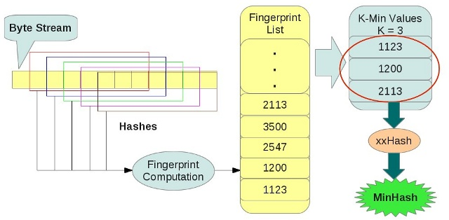
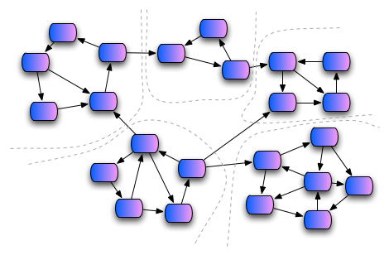
Approach
Standardize and Normalize fields as much as possible
Find fingerprint function for each field type
Fingerprint each field into high-dimensional space
Use nearest-neighbors algorithm to find candidate matches (based on fingerprint)
Calculate pair-wise similarity of candidates
Use connected components / “community detection” to find likely matches

Slide 12
Thank You johannes@fluquid.com

